Slide 2
Git introduction

Slide 3
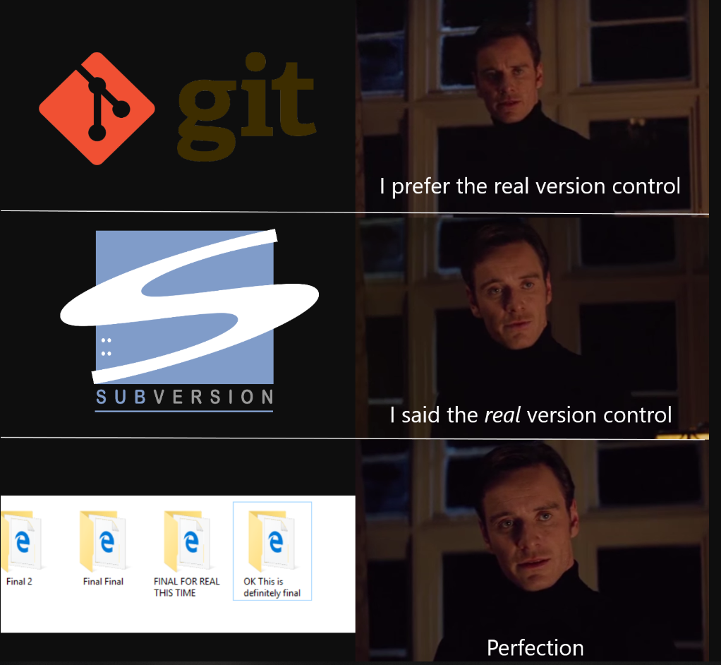

Slide 4
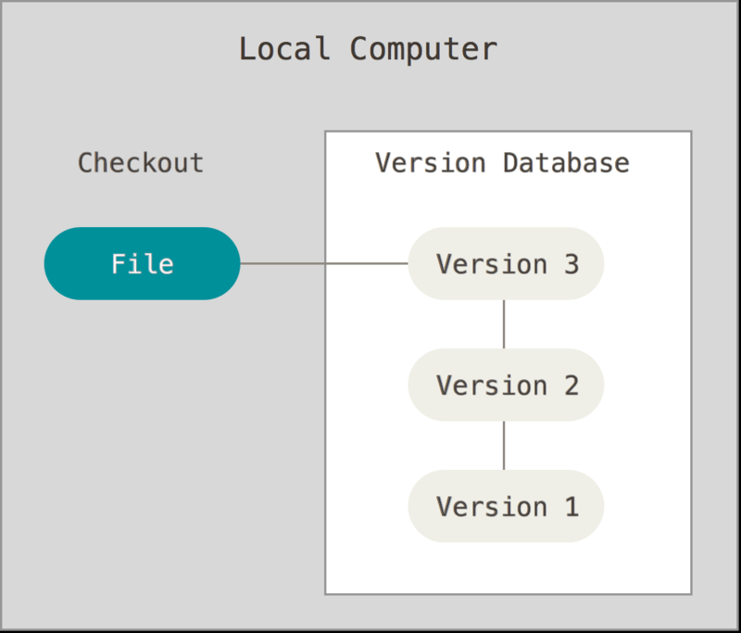
What is a Version Control System
+ Simple
- Bug-prone
- Makes it hard to cooperate.

Slide 5
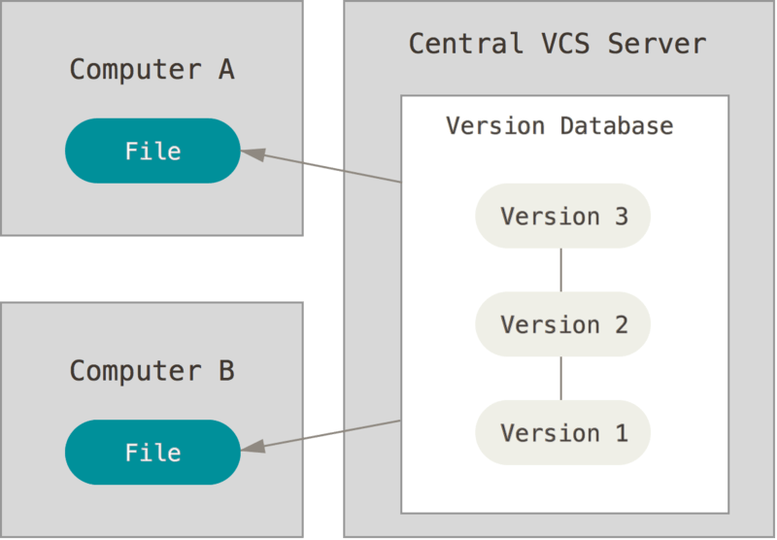
Centralized version control systems
+ Easy to understand
+ Easy to administer
+ You know what everyone is doing.
- Slow
- Requires internet connection
- Single point of failure.

Slide 6
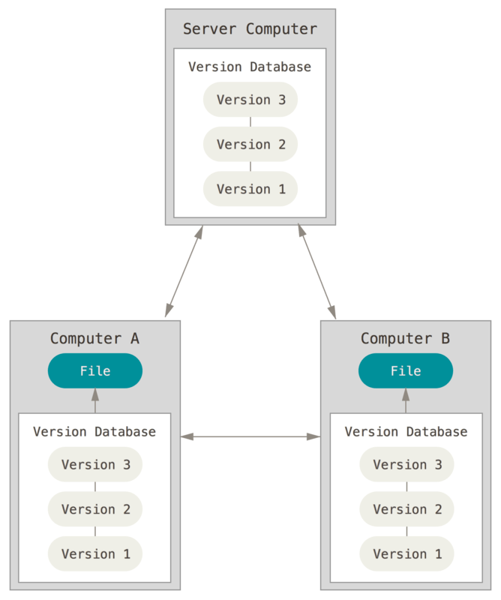
Distributed version control systems
+ Most of the operations are local
+ Extremely fast
+ It’s near impossible to shot yourself in the leg
+ Multiple repositories.
- Not upfront intuitive.

Slide 7


Slide 8
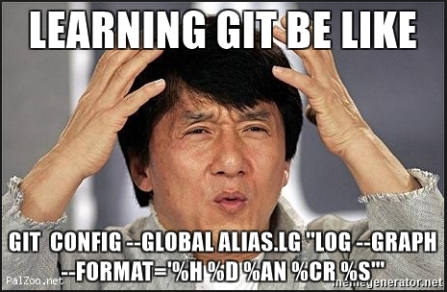

Slide 9
QUESTIONS?
Notes:
Use the ”hilighted content” slide whenever you

Slide 10
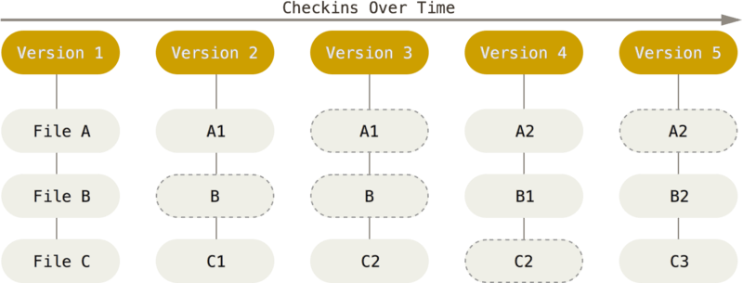
Git’s approach to data

Slide 11
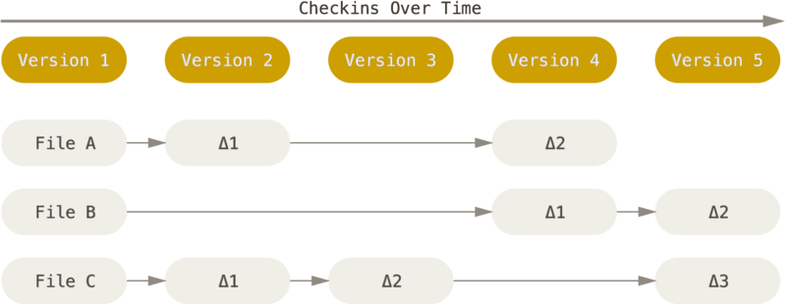
Other systems’ data model

Slide 12
Storage and SHAs
.git
SHA-1 for snapshots: 24b9da6552252987aa493b52f8696cd6d3b00373
Git mostly only adds data.

Slide 13
What Git client should I use?
Official command-line Git client
But generally it’s irrelevant, you can go for TortoiseGit/SourceTree. Just make sure whether your client has installed Git for you.

Slide 14
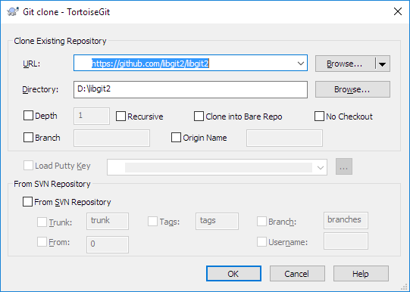
Git Clone
git clone https://github.com/libgit2/libgit2 [folder-name]

Slide 15
Git Init
git init - to create new (empty) repository in current directory

Slide 16
Git Commit
Config required for commit
Without the commit the info is not recorded in the repo, we commit with ‘git commit’ command
Commits should be atomic.
commands:
git commit - add new commit
git commit -m <message> - provide message for commit
git commit -a - add all changes in working directory to next commit

Slide 17
Git Add
In order to provide some data that will be put in next commit (after git commit) we need to use git add command
commands:
git add <file> - add <file> to stage (changes to be committed)
git add -A - add all files
git add . - add all files in current directory and subdirectories

Slide 18
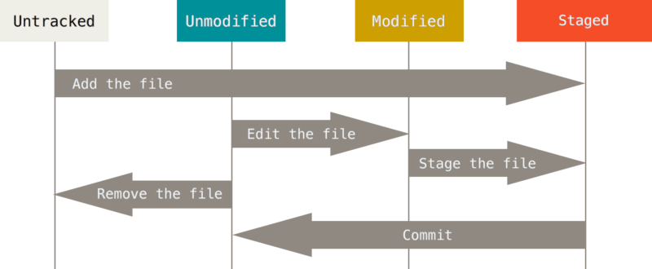
File states
File in Git can be either:
Untracked – Git sees it in the repository but knows nothing about it
Staged – It was added to the staging area with ‘git add’
Unmodified – Normal unchanged file in the repository
Modified(Deleted/Renamed) – File from the repository was modified.

Slide 19
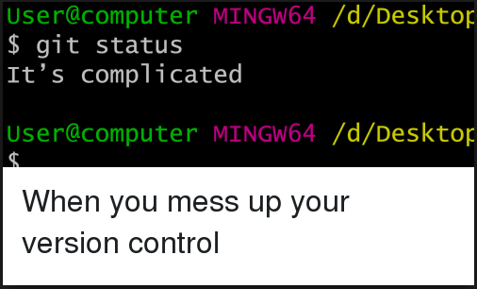

Slide 20
Git status
$ git status
…
Changes to be committed:
(use "git reset HEAD <file>..." to unstage)
new file: README
Changes not staged for commit:
(use "git add <file>..." to update what will be committed)
(use "git checkout -- <file>..." to discard changes in working directory)
modified: CONTRIBUTING.md

Slide 21
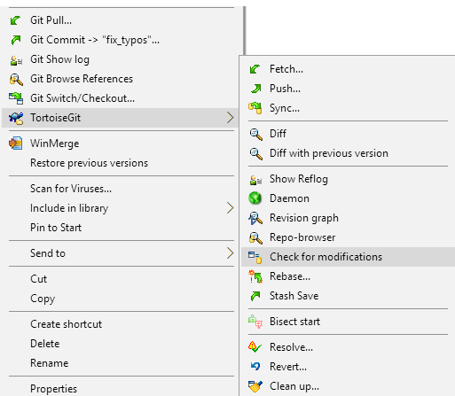
TortoiseGit status

Slide 22
QUESTIONS?
Is it possible to get back the file that was deleted a long time ago?
With which command do we introduce changes to the repository?
How to move a file to the staging area?
Notes:
Use the ”hilighted content” slide whenever you

Slide 23
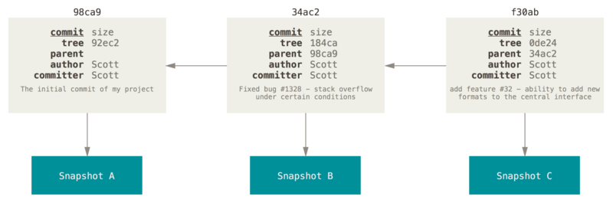
Closer look on commits

Slide 24
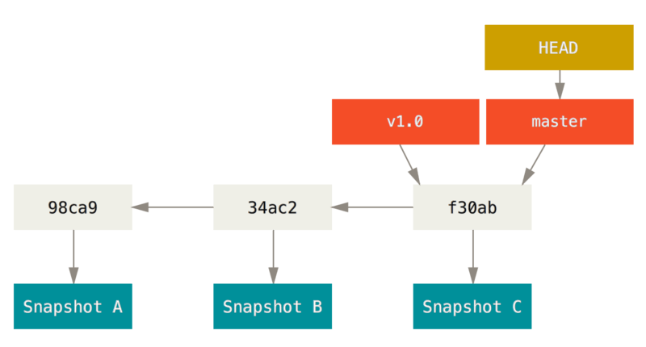
Branch and its history

Slide 25
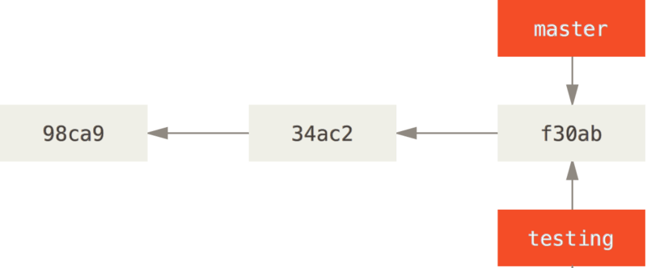
Creating a new branch
“git branch testing” / “create branch” in TortoiseGit

Slide 26
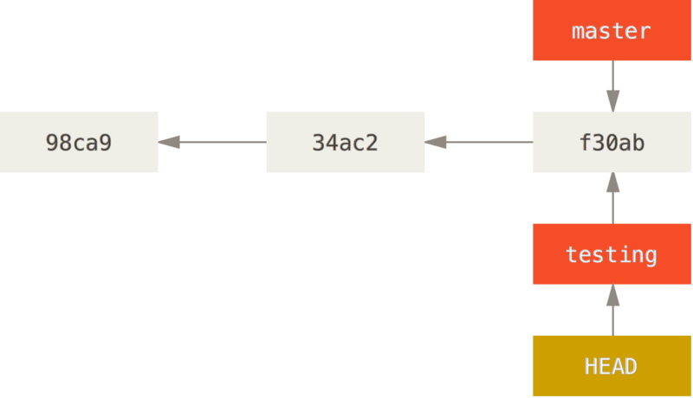
Head of a branch

Slide 27
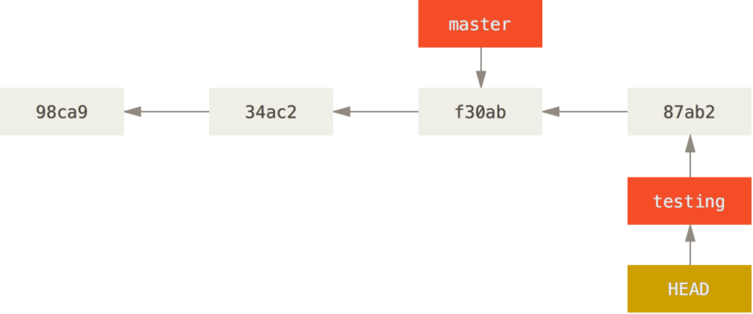
Head moves along with commits

Slide 28
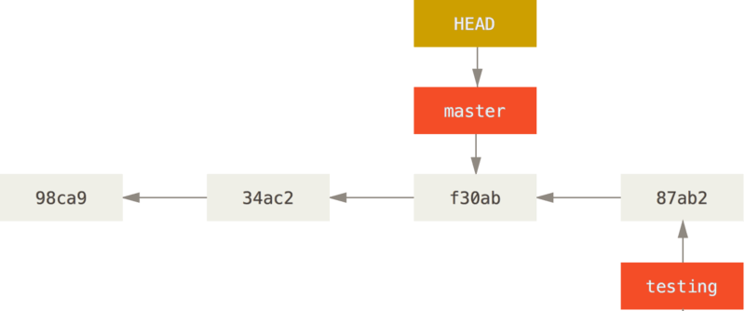
Head moves along with branches
“git checkout master” / “switch/checkout” in TortoiseGit

Slide 29
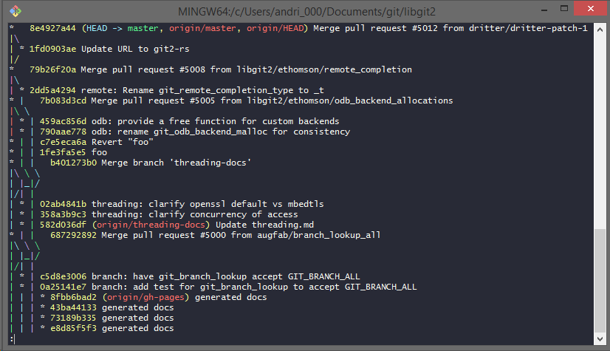
History of the repository
‘git log’ shows the list of commits
‘git lola’ alias for pretty tree in command line(google how to setup it)

Slide 30
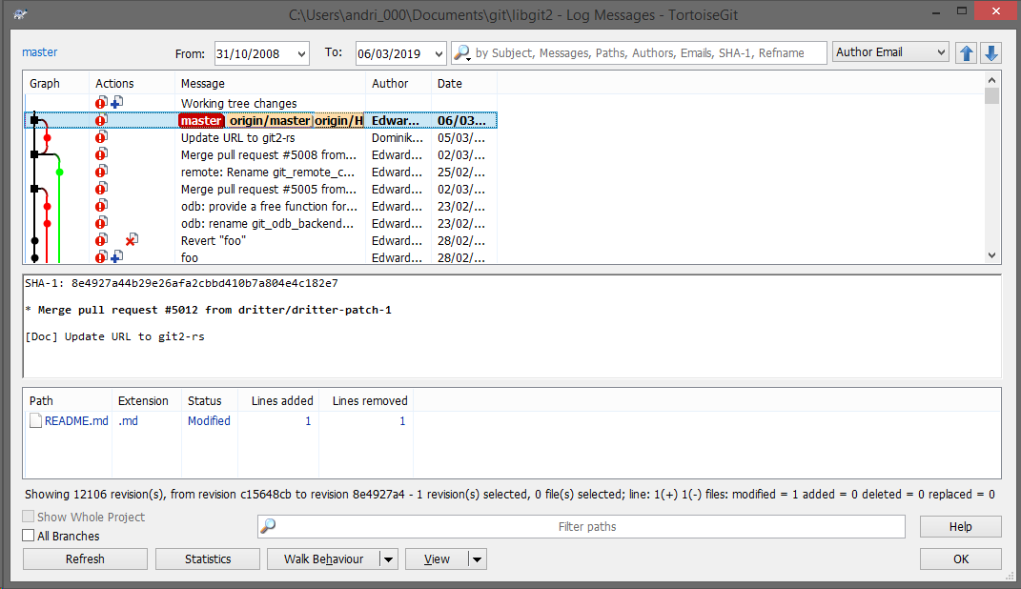
History in TortoiseGit

Slide 31
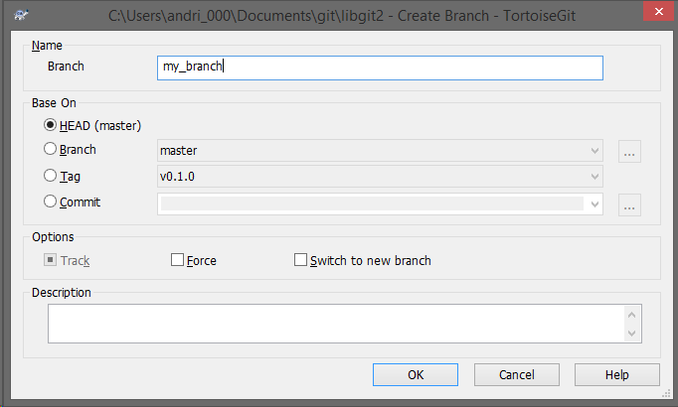
Create branch from another branch

Slide 32
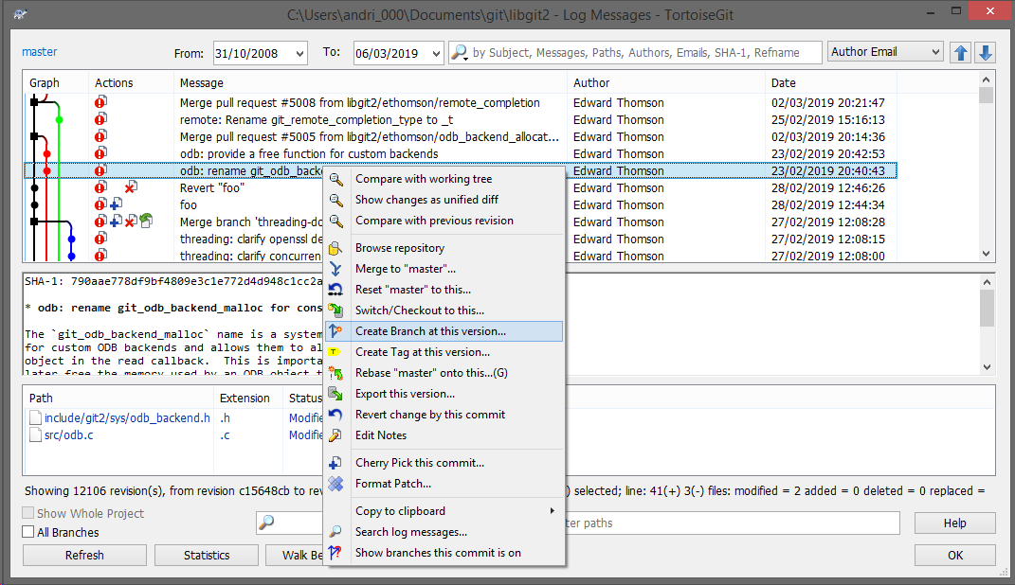
Create branch from commit

Slide 33
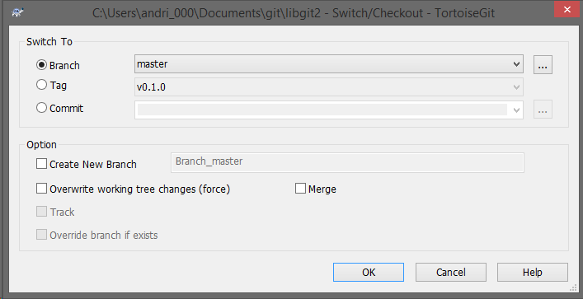
TortoiseGit switch/checkout

Slide 34
Summary
I understand how to clone a repository and why I need to do this. I know how to add new files to the repository, modify the existing ones and commit that to the repository. I’m able to create a branch and know what HEAD is.

Slide 35
QUESTIONS?
Notes:
Use the ”hilighted content” slide whenever you

Slide 36
Homework
- Create your own repository
- Clone it
- Add files, make a commit
- Add 5 files, after that commit first 3 of them and after that the other 2
- Unstage files
- Play with branches creation
- Play with checkout
Notes:
Use the ”hilighted content” slide whenever you

Slide 37
Thank you

